Slide 1
Queues
Programming – Code Design and Data Structures

Slide 2
Contents
Revision of Stacks
Queues
In real life
Properties and Operations of Queues
Deques

Slide 3
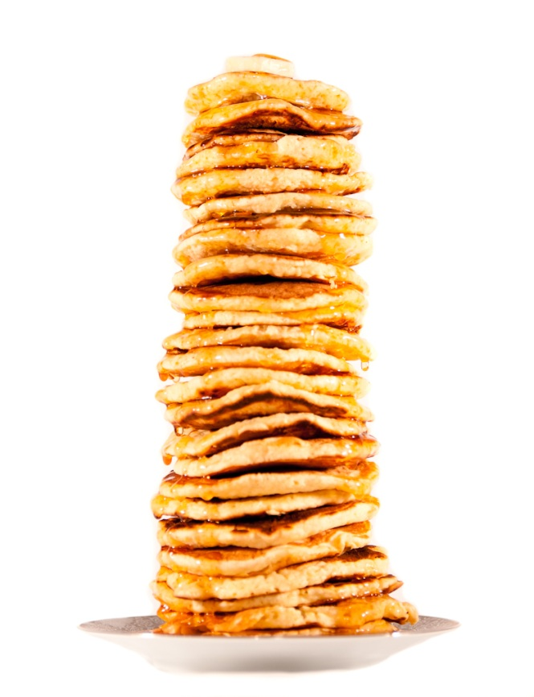
Revision of Stacks
Stacks
Last In First Out
Push onto the Top
Pop off of the Top

Slide 4
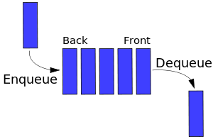
Queues
Queues work using the FIFO concept (First In First Out)
First object pushed onto the queue is the first one out
Like stacks, we can only push and pop an object on and off the queue
i.e., no iterators
Often used for buffering
e.g, loading and playing sound
Notes:
A queue is a bit a bit like a stack, except that in a queue new items are added to the rear of the queue, and items can be removed from the front.
Compare this to a stack, where additions and removals happen at the same end.
This makes a stack a LIFO (last in, first out) structure, whereas the queue is a FIFO (first in, first out) structure.

Slide 5
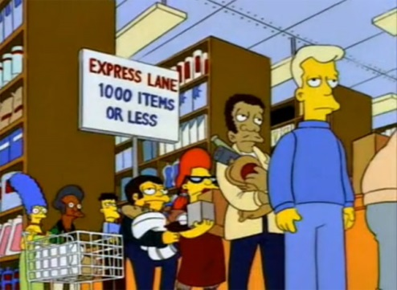

Queues in Real Life
Waiting at the checkout
First person to enter the line gets served first
Customers join at the end… usually

Slide 6
Properties
The only element you have access to is the top element
The front of the queue
i.e., the element that was added first
You can not iterate over the queue or access other elements in the queue
New objects get added onto the end
The back of the queue
Notes:
A queue holds an ordered sequence of items
A queue has a limit on the number of items it can hold
You should be able to create an empty queue
You should be able to check whether a queue is empty / full
You should be able to add an item to the end of a queue
You should be able to remove an item from the front of a queue
You should be able to determine the number of items in the queue
As with a stack, there is no way to iterate through the items in a queue

Slide 7
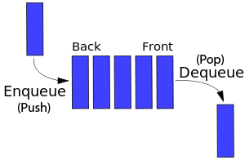
Operations of a Queue
A queue has very similar operations to a stack:
empty(): Returns true if queue is empty
size(): Returns the number of elements
push(value): Adds value to the back of the queue (enqueue)
pop(): Removes the front element of the queue (dequeue)
front(): Returns the front value of the queue, without removing it
back(): Returns the back value of the queue, without removing it

Slide 8

Implementation
Often implemented using Linked Lists
Fast to add items to the back of the queue
push(value) - creates a new node and sets it as the first node in the Linked List, setting its next node pointer to the previous first node
Same as a Double Linked List’s pushFront()
Fast to remove items from the front of the queue
pop() – Set the last node’s previous node’s next pointer to null and make it the new last node, then delete the old last node
Same as a Double Linked List’s popBack()
Notes:
First, you have to decide how to represent the queue data.
One approach is to use new to dynamically allocate an array with the required number of elements.
However, arrays aren’t a good match to queue operations.
For example, removing an item from the front of the array should be followed by shifting every remaining element one unit closer to the front.
Otherwise you need to do something more elaborate like using a circular array.
Using a linked list is a reasonable fit to the requirements of a queue.

Slide 9
A Practical Use
// newtwork server receives messages somewhere and adds them to a queue
void Server::addNewMessage(Message& message) {
// push the message onto the end of the queue
m_messageQueue.push(message);
}
// the game then processes the messages in order
void Game::handleMessages() {
// cap the number of messages the server handles each frame to 10
for(unsigned int i = 0; i < 10; ++i) {
// stop processing if no messages
if (m_messageQueue.empty())
break;
// grab the message from the front of the queue
Message& message = m_messageQueue.front();
// TODO: handle the message some way
// remove the message from the queue
m_messageQueue.pop();
}
}
Notes:
Message handling
Notes: The Priority Queue
Specification: A priority queue is analogous to a line-up for movie tickets. However, in these queues the more important elements are allowed to move to the front of the line. When inserting an element, its priority must be specified. This priority can later be changed. When removing, the element with the highest priority in the queue is removed and returned.

Slide 10
Deques
Suppose you wanted to get access to the back end of the queue?
You cannot in a standard Queue
A Deque is a double-ended queue and allows items to be inserted and removed from either end of a queue

Slide 11
Applications of Deques
One example where a deque would be useful is as a palindrome checker
Is RADAR a palindrome?
Spelled the same way backwards and forwards

Slide 12
Operations of a Deque
A deque has some additional and modified operations to a queue:
pushback(value): Adds a value to the end
popBack: Removes element from the end
pushFront(value): Adds a value to the front
popFront: Removes element front the front

Slide 13
Implementation
Can be implemented as a doubly-linked list:
The start and end pointers provide access to the front and back of the deque
The next and prev node pointers provide a means to insert or remove elements from the front or back
Can also be implemented as a dynamic array
Provides random access to any of the deque’s elements

Slide 14
Summary
Queues are important and useful in programming when we wish operate on items in the order they were inserted
Deques are useful when we need to operate on and insert to both the front and back of a queue

Slide 15
Further Reading
Prata, S, 2011, C++ Primer Plus, 6th Edition, Addison-Wesley
Sherrod, A, 2007, Data Structures and Algorithms for Game Developers, 1st Edition, Charles River Media
Cormen, T, et al, 2009, Introduction to Algorithms, 3rd Edition, MIT Press

